Slide 1
Software Project Management

Slide 2
Software project management
Concerned with activities involved in ensuring that software is delivered on time and on schedule and in accordance with the requirements of the organisations developing and procuring the software.
Project management is needed because software development is always subject to budget and schedule constraints that are set by the organisation developing the software.

Slide 3
Distinctions that make Software management Difficult
The product is intangible.
Software engineering is not recognized as an engineering discipline with the same status as mechanical, electrical engineering, etc.
The software development process is not standardised.
Many software projects are 'one-off' projects.

Slide 4
Management activities
Proposal writing.
Project planning and scheduling.
Project costing.
Project monitoring and reviews.
Personnel selection and evaluation.
Report writing and presentations.

Slide 5
Project planning
Probably the most time-consuming project management activity.
Continuous activity from initial concept through to system delivery. Plans must be regularly revised as new information becomes available.
Various different types of plan may be developed to support the main software project plan that is concerned with schedule and budget.

Slide 6
Project planning process
Establish the project constraints
Make initial assessments of the project parameters
Define project milestones and deliverables
while project has not been completed or cancelled loop
Draw up project schedule
Initiate activities according to schedule
Wait ( for a while )
Review project progress
Revise estimates of project parameters
Update the project schedule
Re-negotiate project constraints and deliverables
if ( problems arise ) then
Initiate technical review and possible revision
end if
end loop

Slide 7
Activity organization
Activities in a project should be organised to produce tangible outputs for management to judge progress.
Milestones are the end-point of a process activity.
Deliverables are project results delivered to customers.
The waterfall process allows for the straightforward definition of progress milestones.

Slide 8
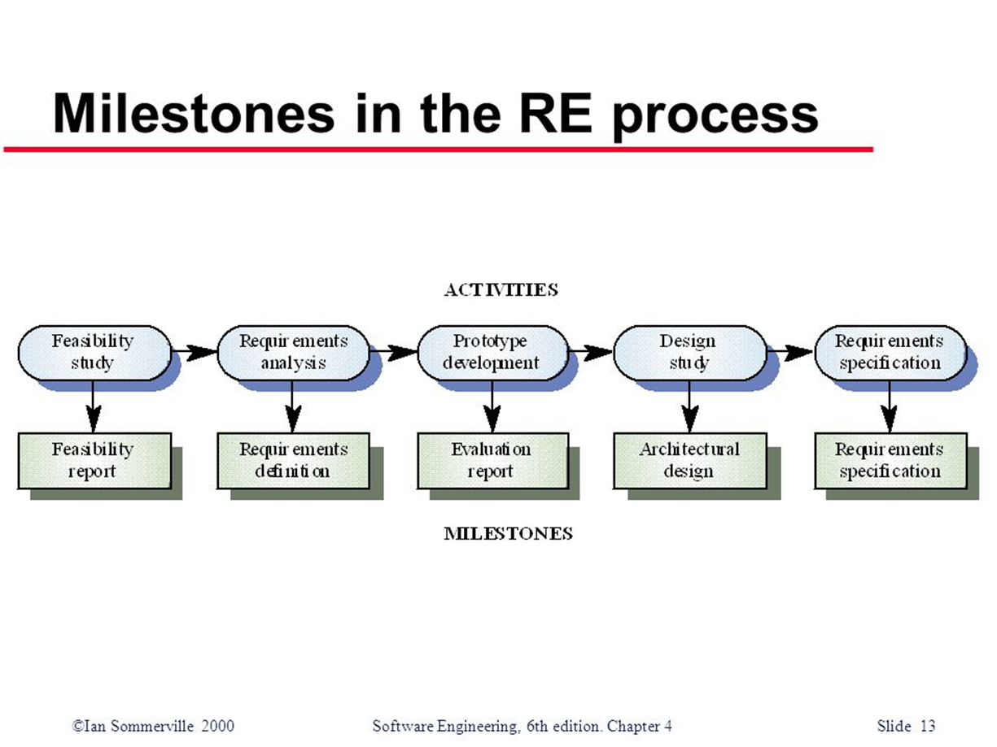

Slide 9
Project scheduling
Split project into tasks and estimate time and resources required to complete each task.
Organize tasks concurrently to make optimal use of workforce.
Minimize task dependencies to avoid delays caused by one task waiting for another to complete.
Dependent on project managers intuition and experience.

Slide 10
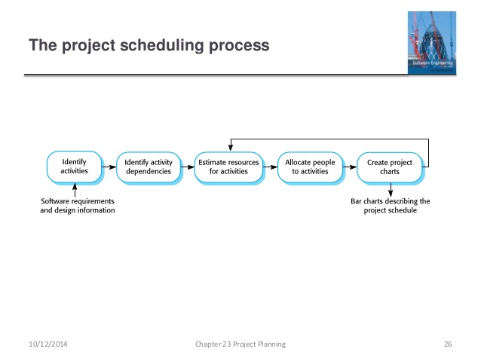

Slide 11
Bar charts and activity networks
Graphical notations used to illustrate the project schedule.
Show project breakdown into tasks. Tasks should not be too small. They should take about a week or two.
Activity charts show task dependencies and the critical path.
Bar charts show schedule against calendar time.

Slide 12

Task durations and dependencies

Slide 13
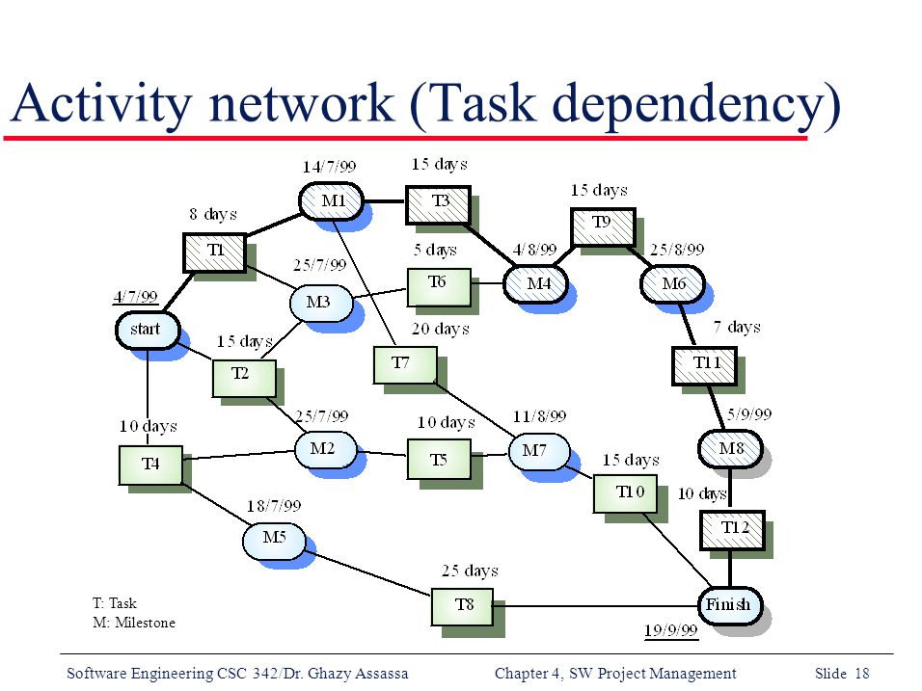

Slide 14
Activity network
Given the dependencies and estimated duration of activities, an activity chart that shows activity sequences may be generated.
This shows which activities can be carried out in parallel and which must be executed in sequence because of a dependency on an earlier activity.
Activities are represented as rectangles; milestones and project deliverables are shown with rounded corners. Dates in this diagram show the start date of the activity.
All activities must end in milestones. An activity may start when its preceding milestone has been reached.
Before progress can be made from one milestone to another, all paths leading to it must be complete. For example, when activities T3 and T6 are finished, then activity T9 can start.

Slide 15
Activity network
The minimum time required to finish the project can be estimated by considering the longest path in the activity graph (the critical path). In figure, it is 11 weeks of elapsed time or 55 working days.
The critical path is the sequence of dependent activities that defines the time required to complete the project.
The overall schedule of the project depends on the critical path.
Any slippage in the completion in any critical activity causes project delays because the following activities cannot start until the delayed activity has been completed.
Delays in activities that do not lie on the critical path do not necessarily cause an overall schedule slippage. For example, if T8 is delayed by two weeks, it will not affect the final completion date of the project because it does not lie on the critical path.

Slide 16
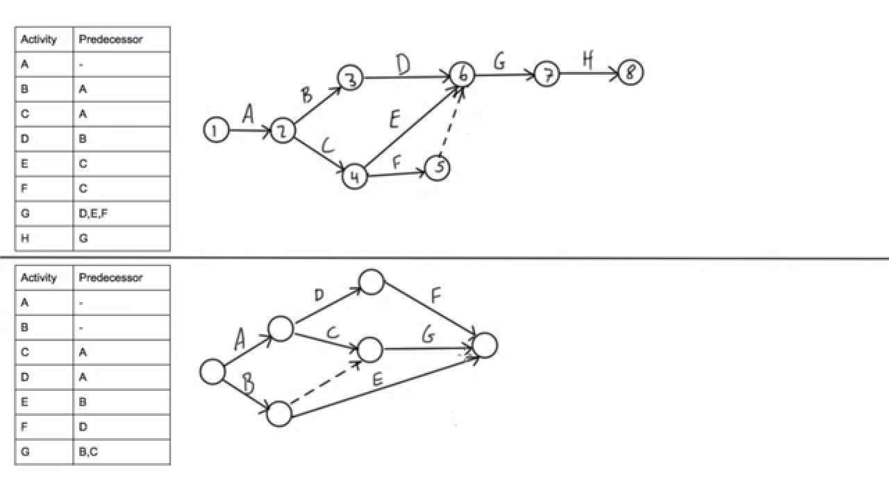

Slide 17
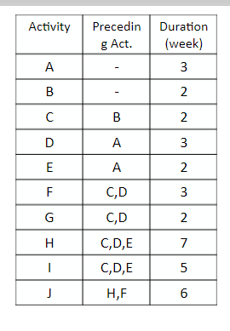
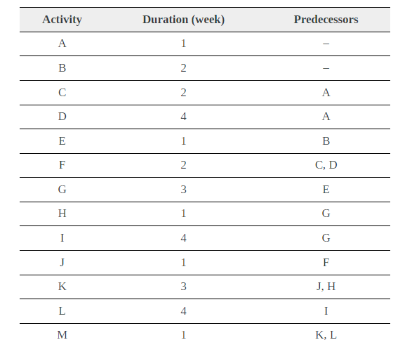
Exercise

Slide 18
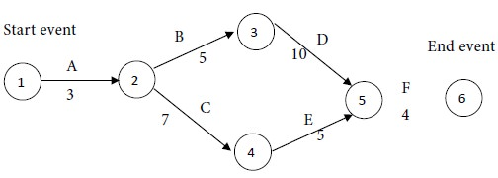
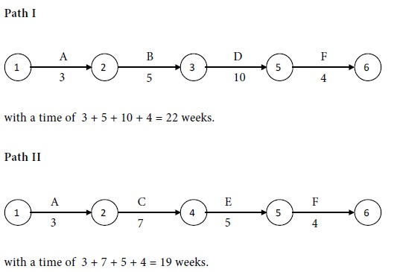
Critical Path
The critical path (or paths) is the longest path (in time) from Start to Finish; it indicates the minimum time necessary to complete the entire project.
Compare the times for the two paths. Maximum of {22,19} = 22. We see that path I has the maximum time of 22 weeks. Therefore, path I is the critical path. The critical activities are A, B, D and F. The project completion time is 22 weeks.

Slide 19
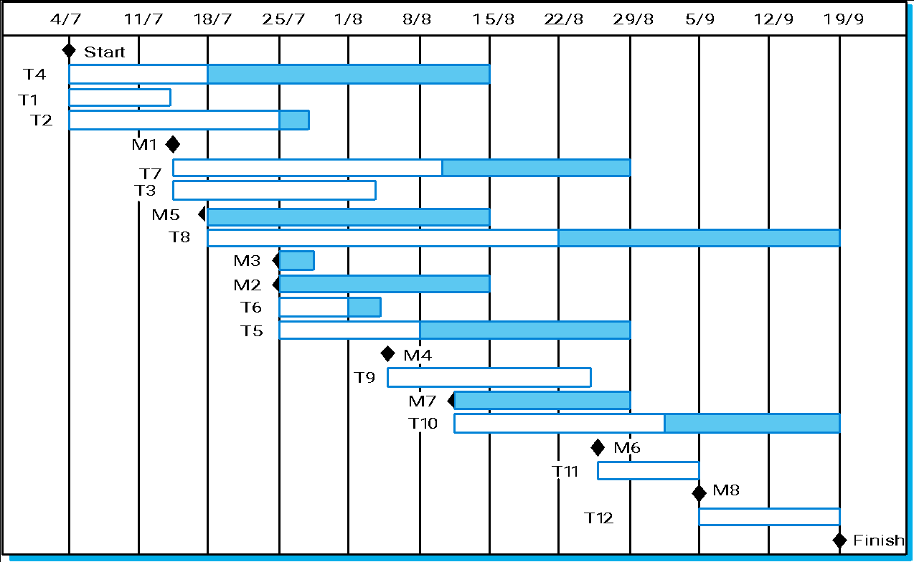
Activity Bar Chart

Slide 20
Activity Bar Chart
Another kind of activity charts used to allocate project work which provide insights into activity dependencies.
This kind of chart called Bar or Gantt chart showing a project calendar and the start and finish dates of activities.
The activities in the bar chart are followed by a shaded bar highlights the flexibility in the completion date of these activities.
If an activity does not complete on time, the critical path will not be affected until the end of the period marked by the shaded bar.
Activities that lie on the critical path have no margin of error and can be identified because they have no associated shaded bar.

Slide 21
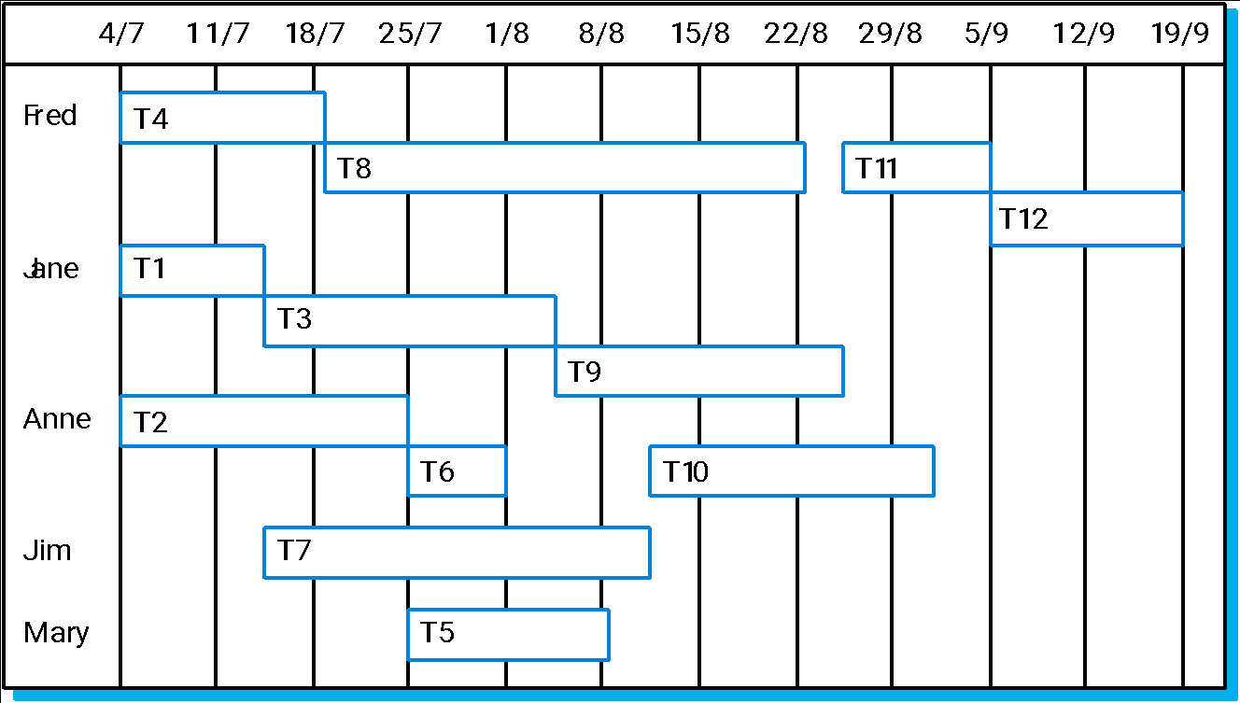
Staff allocation

Slide 22
Risk management
Risk management is concerned with identifying risks and drawing up plans to minimise their effect on a project.
A risk is a probability that some adverse circumstance will occur
- Project risks affect schedule or resources; An example might be the loss of an experienced designer.
- Product risks affect the quality or performance of the software being developed; failure of a purchased component to perform as expected.
Business risks affect the organisation developing or procuring the software. a competitor introducing a new product is a business risk.

Slide 23
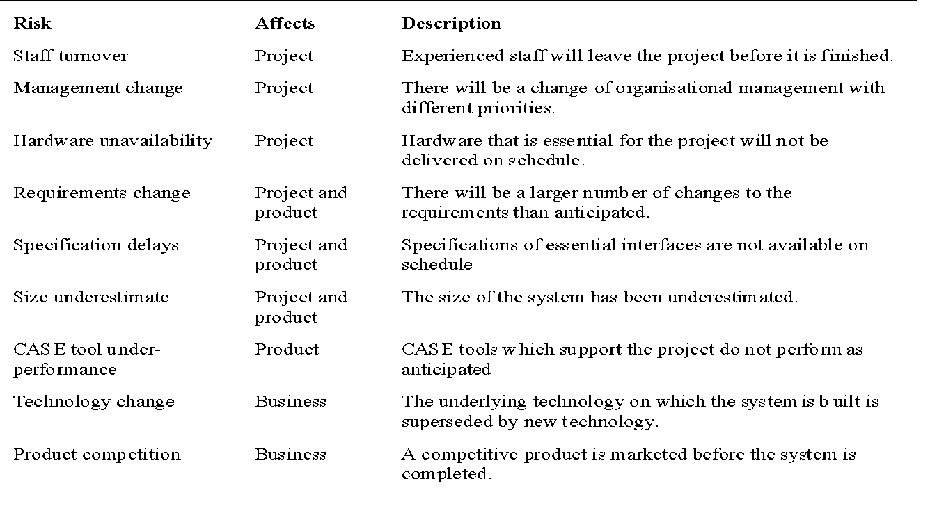
Software risks

Slide 24
The risk management process
Risk identification
Identify project, product and business risks;
Risk analysis
Assess the likelihood and consequences of these risks;
Risk planning
Draw up plans to avoid or minimise the effects of the risk;
Risk monitoring
Monitor the risks throughout the project;

Slide 25
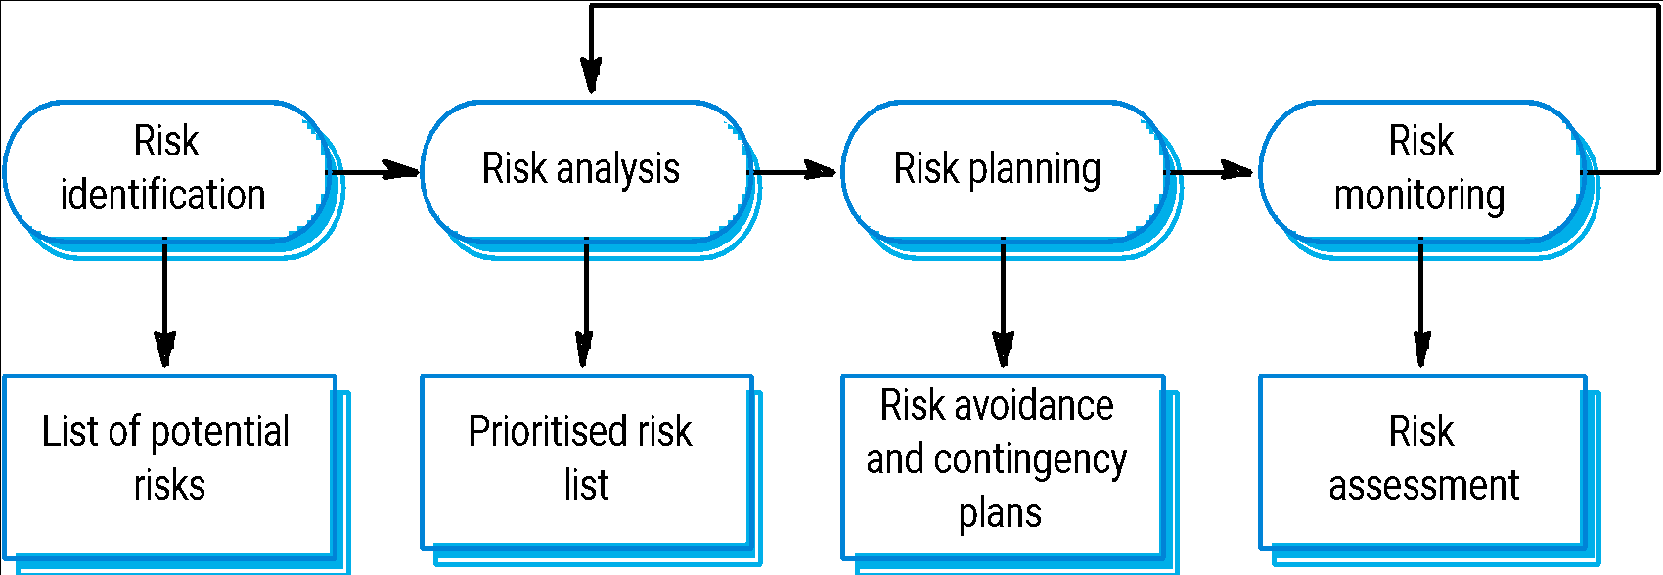
The risk management process

Slide 26
Risk identification
Risk identification is the first stage of risk management which is concerned with discovering possible risks to the project.
Risk identification may be carried out as a team process using a brainstorming approach or may simply be based on experience.

Slide 27
Risk identification
Technology risks.
People risks.
Organisational risks.
Requirements risks.
Estimation risks.

Slide 28
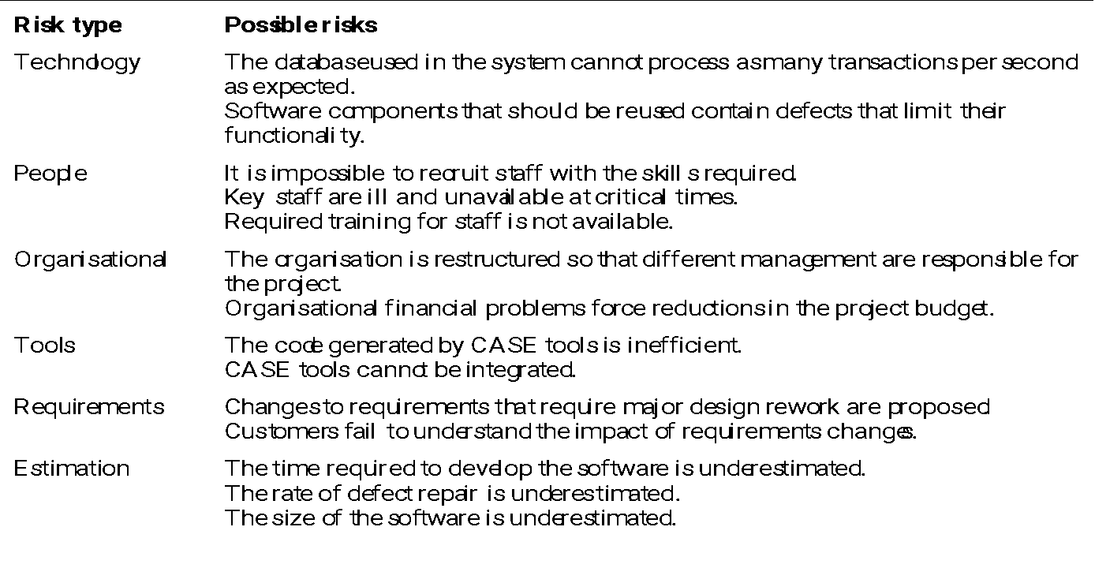
Risks and risk types

Slide 29
Risk analysis
Assess probability and seriousness of each risk.
Probability may be very low, low, moderate, high or very high.
Risk effects might be catastrophic, serious, tolerable or insignificant.

Slide 30
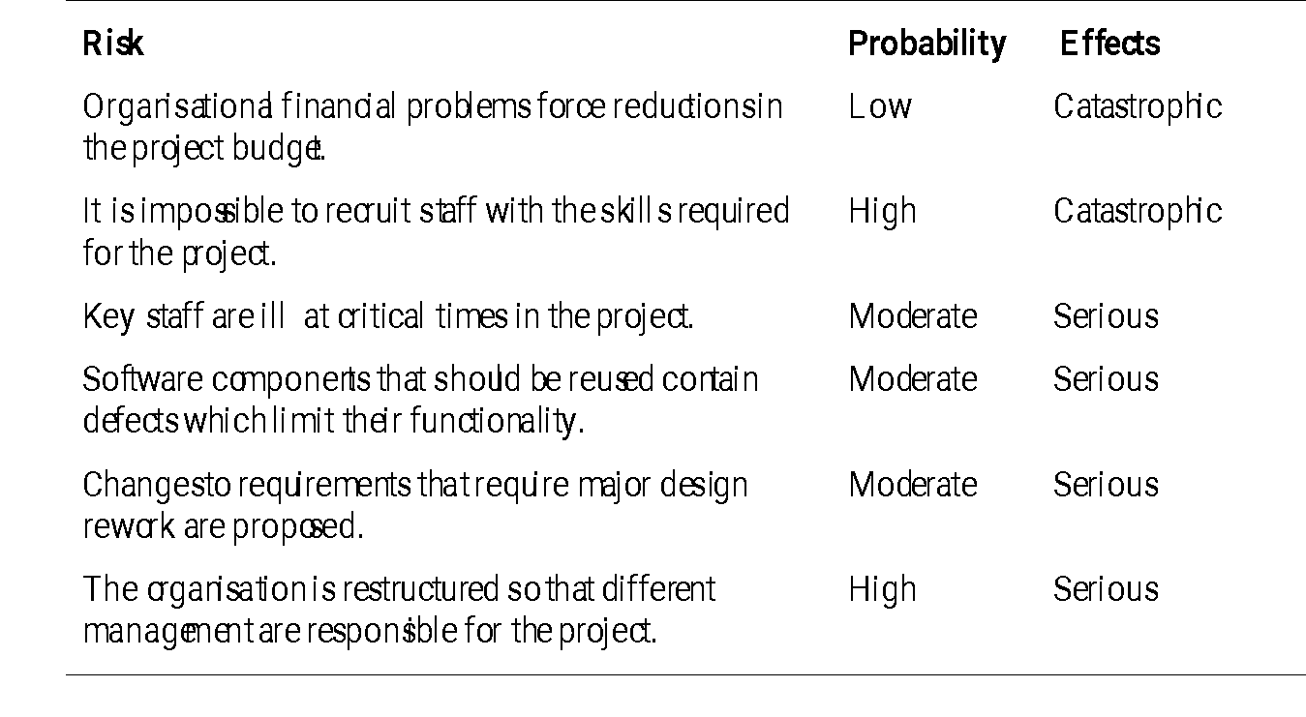
Risk analysis (i)

Slide 31
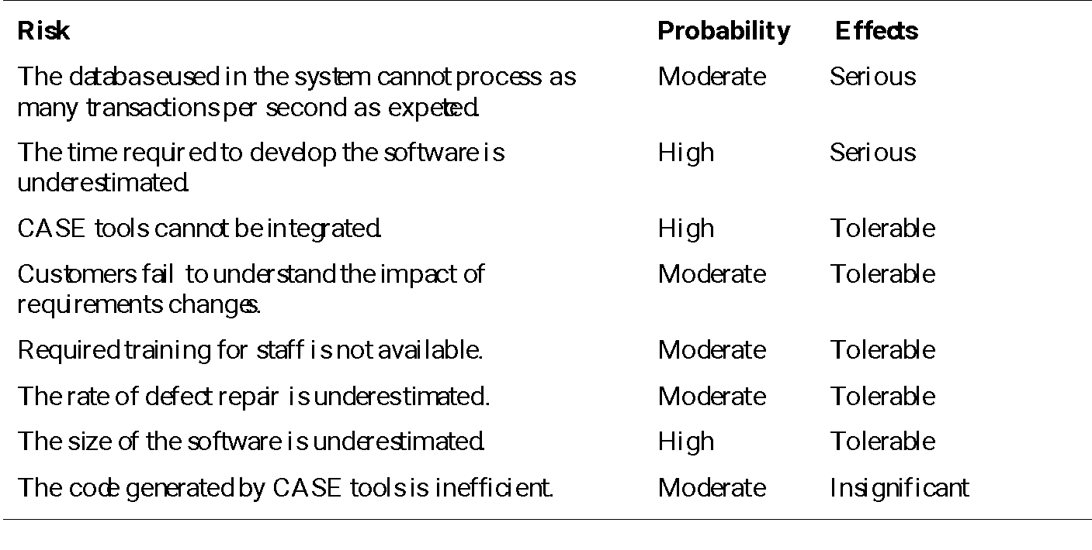
Risk analysis (ii)

Slide 32
Risk planning
Consider each risk and develop a strategy to manage that risk.
Avoidance strategies
The probability that the risk will arise is reduced;
Minimisation strategies
The impact of the risk on the project or product will be reduced;
Contingency plans
If the risk arises, contingency plans are plans to deal with that risk;

Slide 33
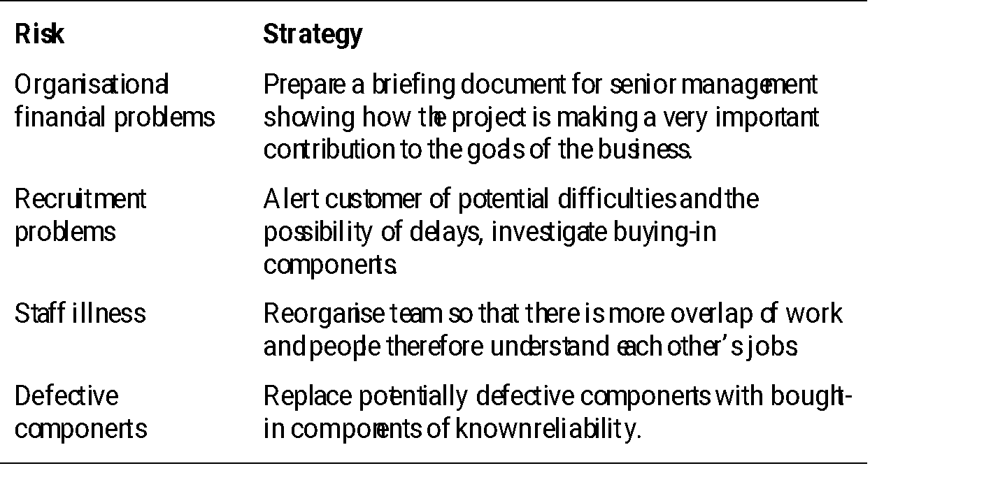
Risk management strategies (i)

Slide 34
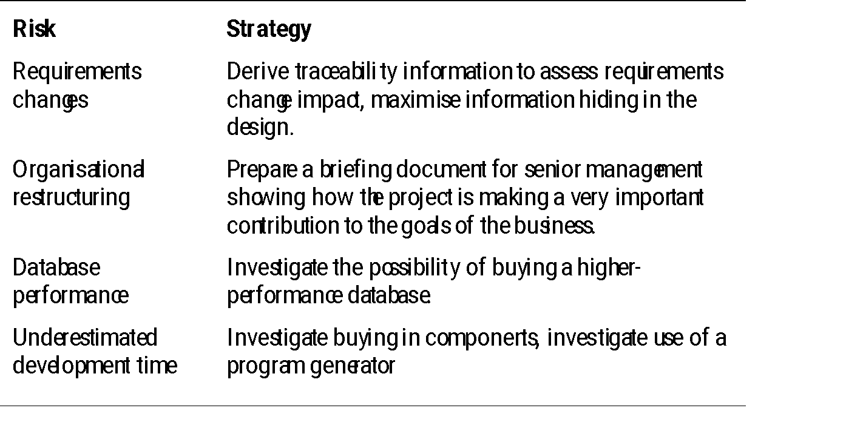
Risk management strategies (ii)

Slide 35
Risk monitoring
Assess each identified risks regularly to decide whether or not it is becoming less or more probable.
Also assess whether the effects of the risk have changed.
Each key risk should be discussed at management progress meetings.
Some factors that give us clues about the risk probability and its effects must be observed. These factors are obviously dependent on the types of risk.

Slide 36
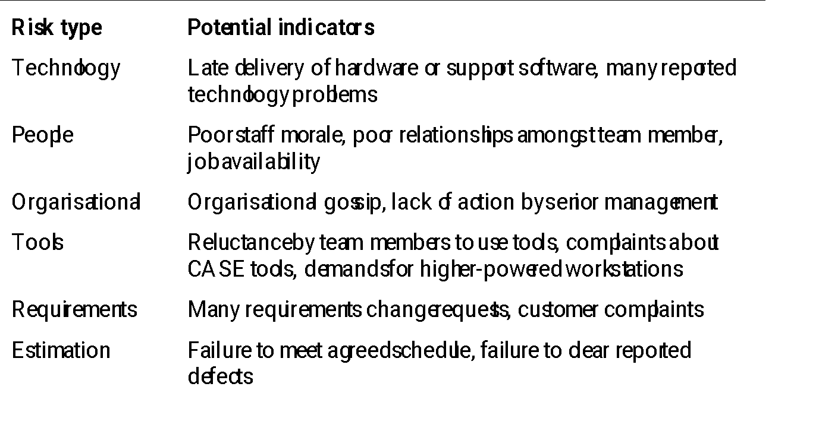
Risk indicators

